Slide 1
Introduction to Intellectual Property (IP) - the who, the what, the how, and the why?
August 2023

Slide 2

The who…. the IP Team

Slide 3
The what…. patents, TMs, designs, copyright, database rights

Slide 4
Types of IP rights…
Patents
the HOW
Designs
the LOOK
Trademarks
the SIGN
[™ ®]
Trade Secrets
the KNOW-HOW
Copyright
the EXPRESSION
[©]
Notes:
Intellectual Property is a suite of legal protections and rights which encourage and reward technical or aesthetic advancement – IP helps ensure financial benefit from inventive effort.
IP rights fall into several major buckets, each with their own legislative systems and scope of protection.
Your job is being the creative geniuses, our job is figuring out the legal stuff – so don’t worry too much about what can or can’t be protected, we want to see everything!

Slide 5
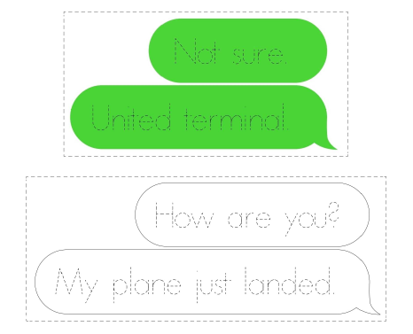
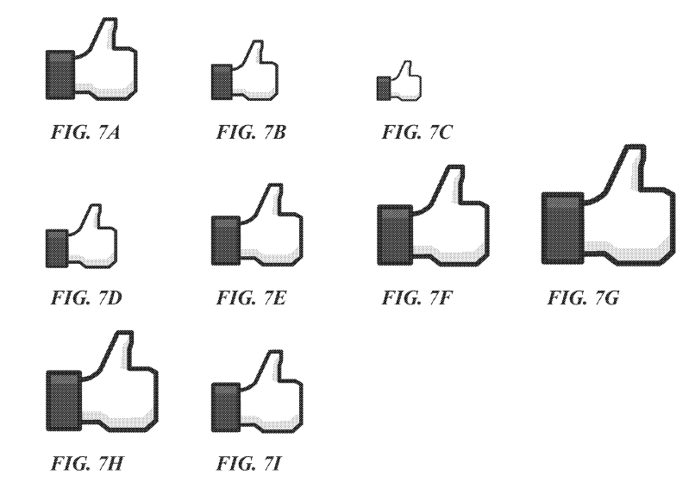
IP you’re probably familiar with…
iMessage “bubble” outlines
Animating a “Like” in Facebook GUI
US Design D742,894
US Patent US10,762,683

Slide 6
The how….
the journey from idea to protected IP
e.g., idea → patent

Slide 7
The why… - why create and maintain an IP portfolio?

Slide 8
“Protect the core; enable the future”
Protect investment in R&D
prevent competitors, or anyone else, from using the company’s ideas for their own profit without our consent or compensation
Protect the company’s reputation
prevent competitors or anyone else, from using or tarnishing good name
Create and protect market share
prevent competitors from copying amazing product that wins market share
prevent competitors from displacing amazing products in market with “copycats”
Make money directly
Licence technology, know-how, etc.
Notes:
Freedom to operate search carried out to figure out if can work invention without infringing other parties’ IP rights.

Slide 9
Patent claim drafting exercise
(Welcome to my world!)

Slide 10
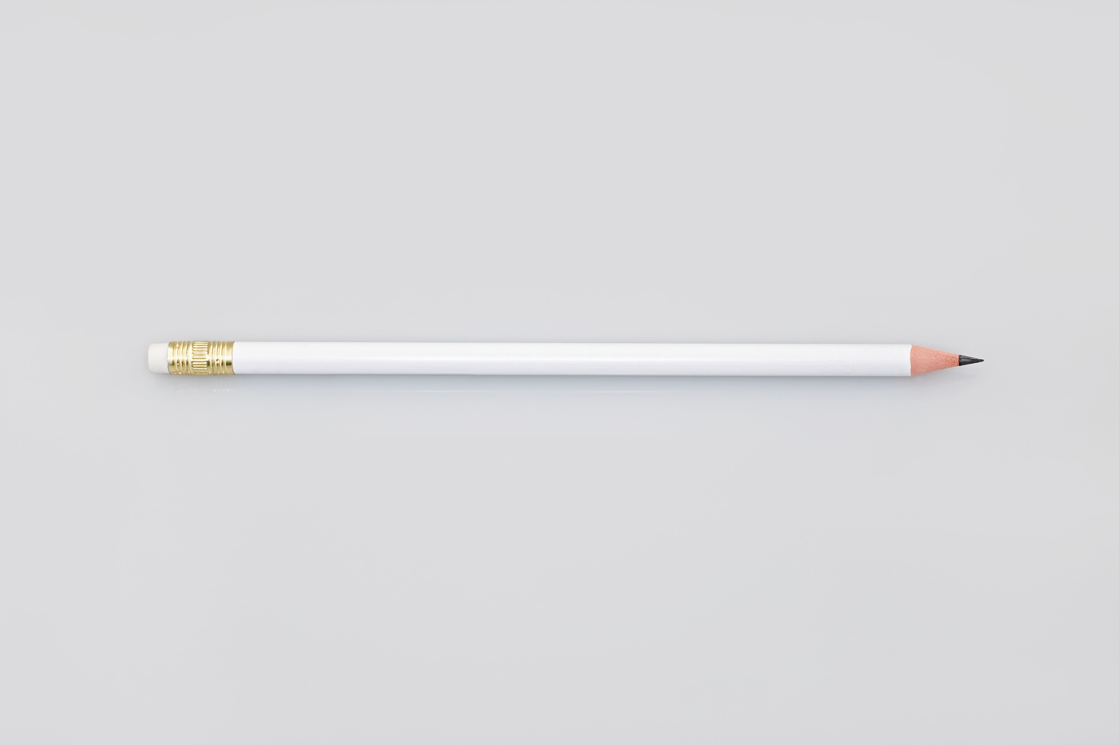
A pencil….

Slide 11
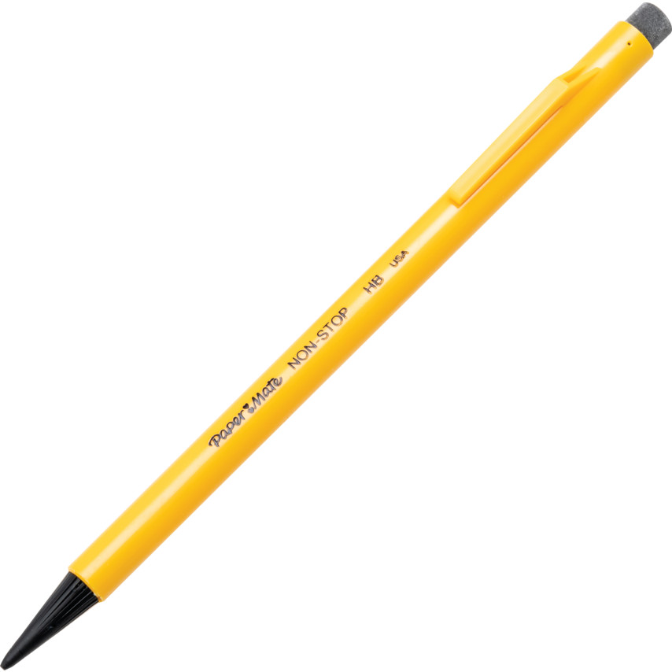
“Prior art”….

Slide 12
A pencil….
A hand-held writing instrument comprising:
(a) an elongated core element that, when brought into contact with a surface, imparts a mark on the surface, and
(b) an elongated holder surrounding and encasing the elongated core element means, said holder protects said core element means from breakage and provides an enlarged gripping means for holding said core-element means,
characterised in that
a portion of said holder is removable by paring to expose an end of said core-element means so as to enable said core element means to impart the mark on the surface.

